Slide 1
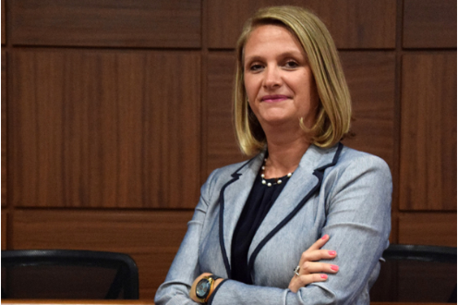
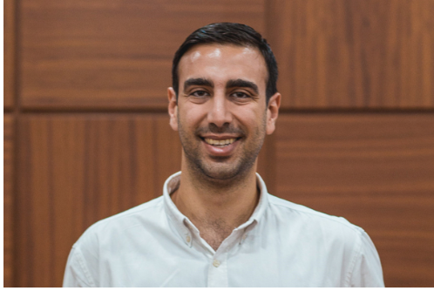
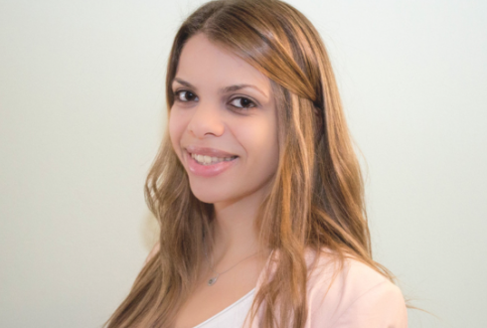
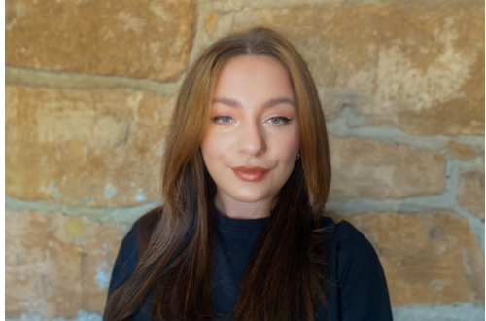
Centre for the Rule of Law and European Values
CRoLEV is a Jean Monnet Centre of Excellence co-funded by the European Union under the Erasmus+ programme 2021-27, Jean Monnet Actions for the years 2022-2025.
We: (i) explore the state of the rule of law within the EU and in neighbouring countries, using empirical research; (ii) investigate the deterioration of the rule of law and EU values in times of crisis; (iii) evaluate the mechanisms available at the EU level to secure European values and rule of law protections; and (iv) deliver research-informed teaching designed to reach academics, students, and professionals, and the civil society across Europe.
Prof. Stéphanie Laulhé Shaelou
Centre Director
Dr. Andreas Marcou
Chief Researcher & Project Manager
Dr. Katerina Kalaitzaki
Senior Researcher
Dr. Alex M. Uibariu
Postdoctoral Researcher

Slide 2
Measuring the Rule of Law
Identifying Rule of Law Indicators
We have reviewed available tools for measuring various aspects of the rule of law, and identified a number of indicators which are pertinent to its measurement in the EU. These are categorised in four pillars: (i) civic engagement; (ii) democratic governance; (iii) functionality of justice; and (iv) democratic values.
Measuring Indicators
We conduct empirical mixed-method research with citizens and residents of EU states, civil society organisations, and professionals to measure their perceptions of the indicators, and combine this with existing primary/secondary data (when available).
Monitoring and Reporting
We:
will create, maintain, and update an interactive dashboard and index on the rule of law and European values;
deliver public lectures, courses, and workshops;
disseminate our findings in a variety of publications and other outputs.

Slide 3
Empirical research
Pragmatist mixed-methods research developing in two stages;
Stage 1:
Two focus groups;
Seven surveys;
Stage 2: two follow-up surveys;
CRoLEV Stage 1 & 2 Surveys: Virtual;
Questions:
Multiple choice – multiple answers;
Multiple choice – single answer;
Likert scale;
Ranking;
Matrix;
Open;
CRoLEV Focus Groups:
Virtual;
Semi-structured;

Slide 4
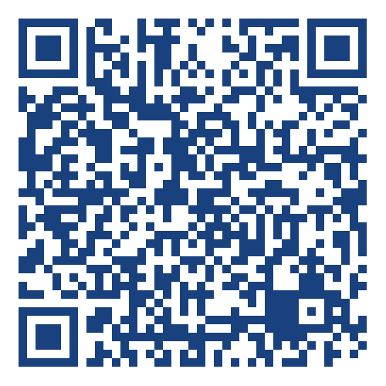
CRoLEV Survey on Access to Democracy
The survey is aimed at citizens and residents of EU member states, as well as Israel, Russia, the Ukraine, and the UK.
The questions explore:
Democratic representation;
Opportunities to participate in democratic dialogue;
Opportunities to shape decision-making at the local, regional, and national levels;
Access to public services;
Access to justice via courts;
Access to legal aid;
Knowledge of, and access to, alternative dispute resolution mechanisms.

Slide 5
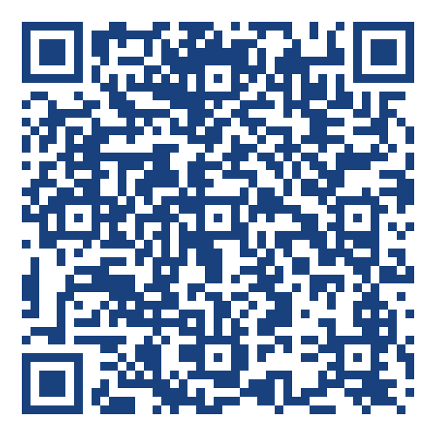
CRoLEV Survey on Media and Disinformation
The survey aims to assess:
public perceptions of the media, and its’ degree of independence from state institutions, public bodies, and other organisations;
the extent to which the media can critique the state without negative consequences;
whether media is adequately diverse so as to reflect the make-up of the society it intends to serve;
participants’ opinion as to media’s role in upholding transparency and political accountability; and
the extent of perceived disinformation in the media (as well as the events/topics where disinformation would be more prevalent).
The survey is aimed at citizens and residents of EU member states, as well as Israel, Russia, the Ukraine, and the UK.

Slide 6
CRoLEV Surveys on Access to Justice
The surveys aim to assess perceptions concerning:
Access to effective judicial protection;
Civic trust in the administration of justice;
Judicial independence and impartiality;
Fairness and proportionality in the exercise of authority by the police;
Due process in the appointment, remuneration, promotion, and dismissal of judges.
There are two surveys:
One aimed at citizens and residents of EU member states, as well as Israel, Russia, the Ukraine, and the UK.
One aimed at legal professionals in any of the aforementioned states;

Slide 7
CRoLEV Surveys on Access to Justice
General Public
Legal Professionals

Slide 8
CRoLEV Surveys on Corruption
Seek to measure and examine:
Perceptions of corruption;
Awareness of and perceptions of effectiveness of existing mechanisms to fight corruption;
Awareness of and perceptions of effectiveness of existing mechanisms to ensure/improve transparency;
Three surveys, aimed at:
Citizens and residents of EU member states, as well as third states;
Specialised NGOs; and
Legal professionals.

Slide 9
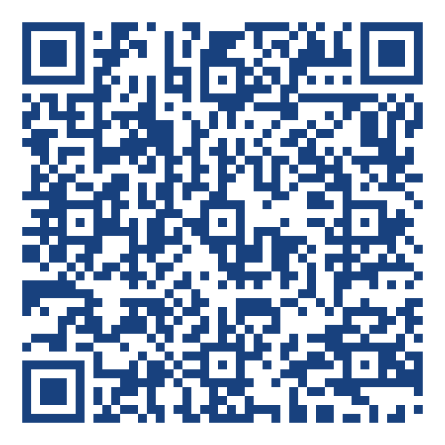
CRoLEV Surveys on Corruption and Transparency
General Public
Legal Professionals
NGOs

Slide 10
Amongst others, CRoLEV:
organises public lectures and intensive courses delivered by world-leading experts on a variety of topics, ranging from counter-terrorism; to transitional justice; to the rule of law, due diligence, and sustainable justice;
hosts a digital library; and
publishes didactic materials;
all of which are free to access. Visit us at:
http://crolev.eu @CRoLEV_Centre CRoLEVcentre

